Slide 1
EMPO Landlords work in partnership with Local Authorities to encourage and promote good property standards and management practices in the private rented sector across the East Midlands.
“Recent Changes to Housing Legislation a quick guide”
Landlord Law
Changes 2018/19

Slide 2
Landlord Law-changes
Why is there so much housing legislation?
Around 4.7 million households in England live in the PRS. Up over 20% since 2010
There is a huge supply problem in our sector with a massive shortage of affordable rental property
Government wants to encourage more B2R development to cater for the increasing numbers of people entering the PRS
B2R sector wants to see higher standards & management practices before investing outside the big cities. They want to see a better regulated sector offering more quality well managed accommodation for people to live in.
Government have therefore embarked on introducing a series of reforms to help rid the sector of bad practices and in doing so help remove the worst offenders from it
Landlord Law
Changes 2018/19

Slide 3
Although the Act became law in May 2016, under this legislation it does not mean all measures will immediately come in to force. In many cases the timeline for many housing reforms under this ACT is still not known
In April 2017 & April 2018 the following measures were introduced under this Act
Civil Penalties, Extension of Rent Repayment orders, Rogue Landlord Register, Landlord Banning Orders
Landlords & Agents can now be fined up to £30K for certain housing offences, mainly around no-compliance or improvement notices and licensing offences. These breaches can also result in tenants applying for RRO and councils applying to the FTT for a banning order when a landlord/letting agent has been convicted of a banning order offence or served with two or more civil penalties.
Landlord Law
Changes 2018

Slide 4
What are Banning Order Offences?
Relevant Housing Offences
Failure to comply with a Prohibition or Emergency Improvement/Prohibition Order under sections 20, 21 and 43 of the Housing Act 2004
Offences under section 32 of the Regulatory Reform (Fire Safety) Order 2005.
Offences in relation to licensing & management of HMOs & failure to licence under p3 of HA 2004
Unlawful/eviction or harassment of a residential occupier in breach of the Protection from Eviction Act 1977 or the Criminal Law Act 1977
Immigration Offences
Letting to someone disqualified from renting as a result of their immigration status
Serious Criminal Offences
Fraud offences
Violence & sexual offences
Offences relating to the production, possession or supply of drugs
Offences of stalking, harassment, property damage, theft, blackmail, handling stolen goods
Those given banning orders will not be able to earn income from lettings for a minimum of 12 months. Breaching a banning order will mean a prison sentence of up to 6 months or an unlimited fine or both
Landlord Law
Changes 2018

Slide 5
Civil Penalties & RRO Orders Landlords BEWARE
In May 2018 five Leeds renters notified their council about their HMO which was not licensed while living there for 8 months.
The council encouraged them to apply for a RRO, they were awarded £15K, the council would have also served a CPN for non-licensing of the HMO.
Landlord Law
Changes 2018

Slide 6
Legislative changes 2018
From 1st April 2018 no new tenancies can be granted on F or below EPC rated properties. This extends to all properties from 1st April 2020
From the 1st April 2019,government requires landlords to pay for energy efficiency upgrades to a minimum of £3.5K incl VAT per property. Where this expenditure does not trigger an E rating or above, landlords can register for a 5-year exemption. Furthermore, an exemption can be applied for, if a landlord can provide 3 estimates stating the installation of the cheapest energy efficiency measure would cost £3.5K or more.
Landlords can still apply for an exemption if the tenant refuses to have the work done.
The ‘no cost to the landlord’ 5 year exemption has been removed and all existing properties with this exemption need to comply with the £3.5K cap after 31 March 2020
Not having an EPC can result in a fine of up to £4K, if the period of non-compliance is over 3 months
Landlord Law
Changes 2018

Slide 7
Legislative changes 2018
Homelessness Reduction Act 2018 Extended the council‘s duties to those who are homeless or
threatened with homelessness. Councils now have a legal duty to prevent homelessness & must spend up
to 56 days in trying to prevent evictions under s21by working with both the landlord and tenant to find other
outcomes.
Gas Installation Boiler Requirement, 6th April 2018- Any new boiler installation MUST include an
additional energy saving device such as a:
Flue Gas Heat Recovery System
Weather Compensation
This requirement was introduced as part of the general drive towards energy efficiency and
to reduce carbon emissions.
Gas Safety (Installation and Use) (Amendment) Regulations 6th April 2018- To provide more
flexibility, GSR can now be renewed up to 2 months before expiry, whilst retaining the original expiry date. In
other words GSR can in theory now last 14 months instead of 12.
GDPR- Landlords need to be registered with the ICO
It became a legal requirement on the 25th May 2018 to issue Privacy notices to tenants outlining
how their personal data is managed & stored
Landlord Law
Changes 2018

Slide 8
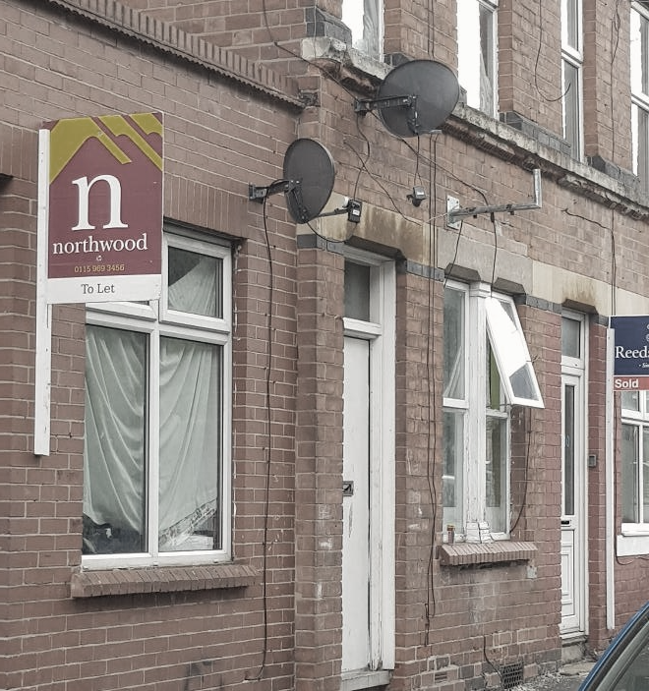
Legislative changes 2018
Changes to the Section 21 Notice (October 2018) & (1st June 2019)
From the 1st October 2018, ALL s21 notices require completing on the prescribed Form 6a. A notice is invalid if issued before the tenant is in receipt of a current GSR an EPC and the correct HTR guide if the tenancy began or was renewed on or after the 1st October 2015. (Remember an unprotected deposit will also invalidate a s21)
A new prescribed form was issued on the 1st June 2019, This version has been updated to include details outlining the restrictions around fees and prohibited payments.
An EPC must be provided to the tenant, an EPC can lapse in a current tenancy (10 year lifecycle) & not impact a s21, but must be current at the commencement date of the tenancy
Three recent court cases have clarified the requirement under the Gas Safety regs 1988 to issue the GSR before the tenant moves into the property, otherwise the s21 notice may be invalid and therefore only a s8 notice can be issued thereafter. A landlord in one of these court cases last month has been given permission to appeal the courts decision.
The correct version of the HTR guide, should be provided at the commencement of a tenancy, it can be served late, but must be served before issuing a s21 notice. If a tenancy has been renewed or become statutory periodic and a newer version of the guide has been released then the landlord needs to serve the newer version prior to serving the s21 notice. GET PROOF OF RECEIPT
Landlord Law
Changes 2019

Slide 9
Legislative changes 2018 Extension of mandatory HMO licensing- 1st Oct 2018
Any property with 5 or more tenants over two or more households
160K more homes becoming HMOs
Definition of HMO covered by mandatory licensing remains the same however purpose built blocks comprising of 3 or more self-contained flats will be exempt. (Even if flats are in multiple occupation)
Minimum HMO bedroom sizes 6.51 m 2 for one person &10.22 m 2 for two persons over 10 years of age & 4.64 m 2 for one child under the age of 10 years
Any area of the room in which the ceiling height is less than 1.5m cannot be counted towards the minimum room size
LA’s can introduce their own minimum HMO bedroom sizes provided they do not set a lower standard (Nott’m 8 m 2)
LA’s must give the licence holder adequate time to comply with the minimum bedroom sizes, the maximum period that can be specified is18 months from a new or renewal HMO licence application.
Landlord Law
Changes 2018

Slide 10
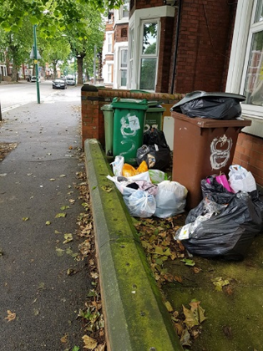
Management of HMO Rubbish, 1st October 2018 LAs can instruct landlords/letting agents in disposing & storing waste
Under this legislation councils can now impose a mandatory condition concerning the provision of suitable refuse storage & disposing facilities for HMOs
Wheelie Bins
Off street Storage
Maintenance
Trade Waste agreement
information for tenants
All licensed HMOs will need to comply with the instructions issued by the LA for the storage and disposal of domestic refuse pending collection.
Ignoring bedroom sizes or failing to comply with waste instructions leaves the licence holder at risk to a civil penalty/prosecution.
Landlord Law
Changes 2018

Slide 11
Legislative changes in 2019
The Fitness for Human Habitation Act- 20th March 2019- IMPORTANT
This legislation will affect all new tenancies from the 20th March 2019
including tenancies which move into statutory rather than contractual
periodic on or after this date and all tenancies from 20th March 2020.
The Landlord & Tenant Act 1985, has been amended so if a landlord rents a property in England with H&S issues and HHSRS hazards then the tenant can seek damages through the court system. Essentially, this legislation forces landlords to promise their properties are fit for human habitation at the start and during a tenancy.
If the tenant decides to go to court the landlord will need to ensure they have evidence that the property is being well maintained and there are measures in place to conduct proper risk assessments and timely inspections
Landlord Law
Changes 2019

Slide 12
Legislative changes in 2019
The Fitness for Human Habitation Act- 20th March 2019- IMPORTANT
Things for landlords to bear in mind
Forces landlord to conduct proper inventories, inspections and conduct work to rectify hazard in a prompt and efficient manner whilst keeping robust records and evidence of works undertaken
Allows an easy process for tenants to seek compensation by simply completing the N1 court form and submitting evidence of dis-repair
Compensation amount up to the court, depends on if the landlord dealt with the hazard in a reasonable time.
Landlord only liable from knowledge during tenancy, if the tenant does not make the landlord aware of a recently discovered hazard, the landlord cannot be expected to fix the problem.
Includes common areas in HMOs and blocks of flats
Landlord Law
Changes 2019

Slide 13
Legislative changes in 2019
The Fitness for Human Habitation Act- 20th March 2019- IMPORTANT
The courts will decide whether a property is fit for human habitation based on the following factors:
the building has been neglected and is in a bad condition
the building is unstable
there’s a serious problem with damp
it has an unsafe layout
there’s not enough natural light
there’s not enough ventilation
there is a problem with the supply of hot and cold water
there are problems with the drainage or the lavatories
it’s difficult to prepare and cook food or wash up
Hazards under Housing Health and Safety Rating System (HHSRS)
How to Rent Guide” updated 31st May 2019 (6th edition)
This edition reference to the fitness for human habitation legislation and the tenant fee ban. The guide explains how rented property must be safe, healthy and free from things that could cause serious harm and if not, tenants can take their landlord to court.
Landlord Law
Changes 2019

Slide 14
Legislative changes in 2019
The Tenant Fees Bill will came into force in England on the 1st June 2019 and applies to all new tenancies and all pre-existing ones from 1st June 2020. The main feature of the legislation means landlords and their agents can no longer charge fees in connection with an AST, tenancies of student accommodation and licences to occupy.
The fees being banned include: fees for having a pet, re-letting fees, credit checking, inventories, end of tenancy cleaning, gardening, referencing and having a property de-flead if pets are allowed.
Payments that can be charged include:
Security deposits, which must be capped at 5 weeks rent
Refundable holding deposits (to reserve a property) to be no more than 1 week’s rent.
Change of tenancy fees to be capped at £50.00 or the reasonable cost(variation of tenancy, permitted occupies, drafting surrender document)
Fees for default of tenancy to be reasonable (costs for late rent payment, replacement keys, locks) Keys- True cost only, cannot charge for time taken to have keys cut. Interest on late rent cannot be more than 3% above BOE rate (14 days in arrears)
Other permitted payments include, TV licence, Council Tax, Utilities, Communication services

Slide 15
Legislative changes in 2019
Things to consider
Update new tenancy agreements from 1st June 2019 to reflect changes- ensure no hidden fees
Fees can still be charged until 31st May 2020 if the agreement commenced or was renewed before the 1st June 2019.
In respect to any deposit amount over the 5 week rent threshold on a pre 1st June 2019 tenancy, EMPO advises you pay back the difference ASAP and in any event by 31st May 2020.
The legislation requires all agents including online to display information about their fees and membership to redress and
client money protection schemes prominently in their office
and on their website.
Where fees have been unlawfully charged Landlords will be
prevented from recovering their property via Section 21 until
the fees have been repaid, unless they can prove their agent
is at fault. The Bill creates a financial penalty of £5K for an
initial breach of the legislation, rising to £30K if convicted of the
same offence within a 5 year period.
Landlord Law
Changes 2019

Slide 16
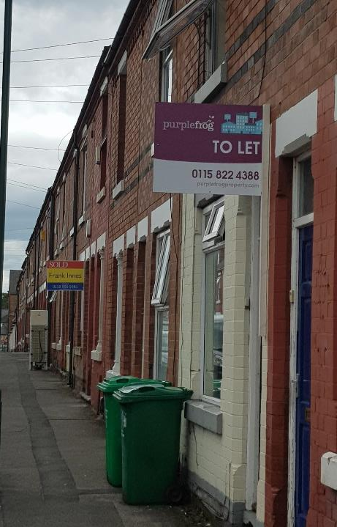
Legislative changes in 2019
Consultation on creating a specialist housing court in England
Government announced on the 14th November the start of a consultation on creating a specialist housing court in England.
The proposals would see the introduction of a digitised court process where landlords and tenants receive a simpler, faster and more effective service in dealing with property disputes.
Government is now reviewing the responses to its consultation which ended on the 22nd January 2019.
Government hopes that a housing court will help improve landlord confidence in offering longer and more secure tenancies. The court will also provide tenants with the ability to quickly enforce rights granted under the Homes Fit for Human Habitation legislation.
Landlord Law
Changes 2019

Slide 17
Legislative changes in 2019
Compulsory Redress Scheme – Late 2019
Linked to the specialist housing court, government have announced their intention to bring forward a single regulator to deal with housing complaints, whether it be sales/lettings/ leasehold or new builds. For residential landlords, there will be a requirement to join or face a fine of up to £5K. The hope is the scheme will help renters have another option to resolve issues faster and mirror changes made to the letting sector, where from the 1st October 2014, it became a requirement for all letting and managing agents in England to become a member of a redress scheme.
There is not a commencement date, but we expect this to happen sometime in late 2019.
S21under the hammer
No fault eviction under Section 21 is being abolished. We are unsure how this is going to work, but a consultation period is being planned. What Government did announce is that landlords will be able to end tenancies where they have legitimate reason to do so, they promise to strengthen the s8 possession process, so property owners are able to regain their home should they wish to sell it or move into it.
Landlord Law
Changes 2019

Slide 18
Legislative changes in 2019
S21under the hammer
There is a concern, if the legislation is drafted badly, it is likely to force landlords to be pickier about who they rent to and to sell up.
The Fair Possession Coalition
EMPO is a panel representative on the Fair Possession Coalition, a taskforce recently set up to lobby government on how the process to replace S21 should evolve. (ARLA, NLA, RLA)
Our key messages include:
There should be an initial ‘starter’ tenancy, as is the case in the social rented sector, before it switches to the open-ended model being proposed by the Government. It is not reasonable to expect the private sector to offer better terms than a social sector which is the beneficiary of generous funding and tax breaks.
There needs to be clear and adequate periods of notice given by a landlord when seeking repossession.
The grounds for repossession need to be made clear to the tenant and fair to the landlord
Landlord Law
Changes 2019

Slide 19
Legislative changes in 2019
S21under the hammer
The level of evidence that a landlord is required to produce when making an application under any ground should not be set at such a high level as to make it unreasonable.
Applications to repossess properties should be timely and easy to use to ensure landlords are not required to pay for expensive legal representation
Councils should be instructed not to encourage tenants to disobey possession orders to leave by a specified date on the basis that the tenant will not be re-housed unless they have held on until the bailiffs arrive.
In Summary
Landlords need confidence that they can swiftly repossess properties for
legitimate reasons. Furthermore Section 21 should not be scrapped unless a
new system is in place that provides landlords with exactly the same level
of confidence which means clear and comprehensive grounds for
possession and a properly funded housing court that does not frustrate
landlords.
Landlord Law
Changes 2019

Slide 20
Legislative changes in 2019
Selective Licensing review backs creation of national landlord register
A government review published last month suggests a national landlord register will complement selective licensing schemes and provide an easy tool for councils to access data on who should have a licence.
The review also recommended twelve key changes to selective licensing schemes. Sadly, there is no mention in the review on how professional landlords and agents who provide decent and safe accommodation to their tenants should be treated.
Landlord Law
Changes 2019

Slide 21
Membership Benefits
A highly competitive building and legal expenses insurance scheme
FREE access to our bank of landlord documentation including AST agreements & home safety/risk assessment documents/GDPR privacy notice
Professional landlord training courses at discounted rates for members
Membership includes a £25.00 discount off your first training course
Invitations to property investor networking events
Advice and assistance completing possession paperwork
A FREE advice helpline provided by hands-on-landlords
Regular local and national updates on legislation affecting your business
Membership brings great money saving products and services
(My Deposits, Tenant Referencing, EPC’s, EICR, Solicitor helpline, Trade Point)
Landlord Law
Changes 2019

Slide 22
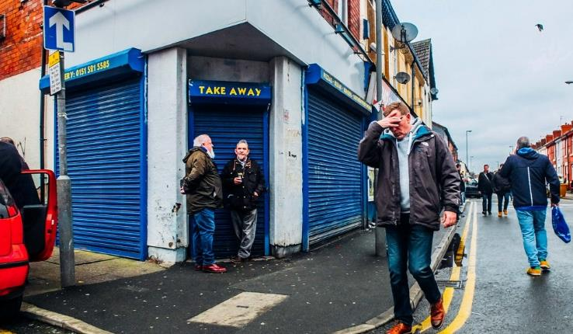
Special Deal
Join EMPO for just £89.00, until 31stJanuary 2021
Join today!!
Join EMPO
Take the stress out of being a landlord

