Slide 1
Lloyds Bank
Buy to Let Presentation
Steve Queenborough
Local Mortgage Manager
East Central Area

Slide 2
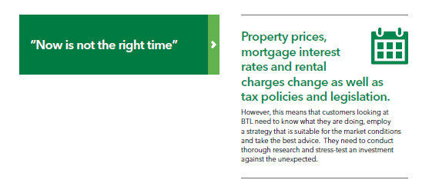
BTL – Current Position

Slide 3
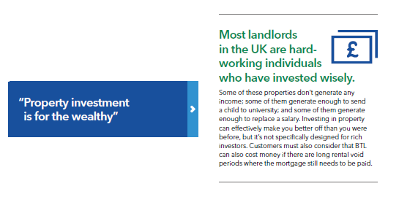

Slide 4
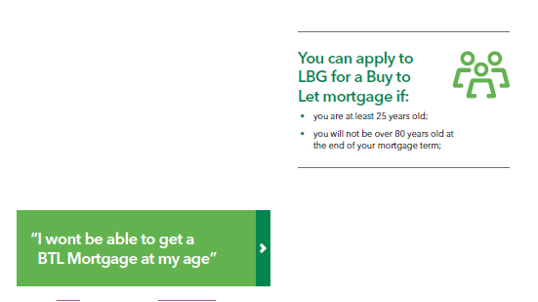

Slide 10
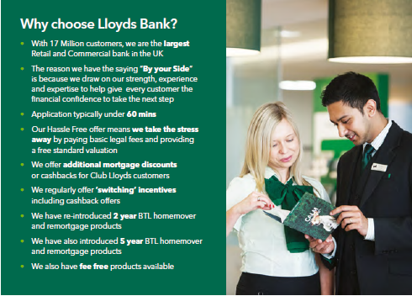

Slide 11
